Slide 1
ME/CFS
Fibromyalgia
Long Covid
Inverness
Lossiemouth
Scotland - Prevalence
Moray
Cumbernauld
Insch (Aberdeenshire)
Aberdeen
Glasgow
Tayside/Perth/Angus
Cathcart (Glasgow)
Montrose
Paisley
St Andrews
Inverclyde
Glenrothes (Fife)
Ardrossan (North Ayrshire)
Coaltown of Wemyss (Fife)
Edinburgh & Lothians
Irvine
West Lothian
Kilmarnock
Falkirk
Stranraer
Grangemouth
Wigtown
Newarthill (North Lanarkshire)

Slide 2
ME/CFS
Fibromyalgia
Long Covid
Scotland – Support Groups
Support Group Name | What They Support | E‑mail Address | City / Area
Fife Fibromyalgia Support Group (Coaltown of Wemyss) | Fibromyalgia / ME / CFS | chair.fibro@gmail.com | K i r k c a l d y (Fife)
Inverness ME / Fibromyalgia / CFS Support Group | ME, Fibromyalgia, CFS | glenesk28@hotmail.co.uk | Inverness
Montrose Fibromyalgia Support Group | Fibromyalgia | am‑fm@fsmail.net | Montrose (Angus/Tayside)
Wigtown FM & Long‑Term Conditions Group | Fibromyalgia & long‑term conditions | jrw4071@aol.com | Wigtown area
Aberfeldy & Perthshire Fibromyalgia Support Group | Fibromyalgia | pageelma@gmail.com | Aberfeldy / Perthshire
West Lothian Fibromyalgia Support Group | Fibromyalgia | (info via website) | West Lothian
West Lothian ME Self Help Group (WLMESH) | ME / CFS | wlmesh@live.co.uk | West Lothian
Borders ME Group (BMEG) | ME / CFS / Fibromyalgia | lauder4492@hotmail.com | Scottish Borders
Pain Association Scotland | Chronic pain & long‑term conditions | info@painassociation.co.uk | Perthshire (covers all Scotland)
Thistle Foundation (Lifestyle Management / self‑management courses) | ME/CFS, fibromyalgia, chronic fatigue and multiple conditions | via Thistle Foundation enquiry forms or info@thistle.org.uk | Scotland‑wide (based Perth)
Versus Arthritis Scotland (Scotland office) | Arthritis / joint‑related chronic pain | scotland@versusarthritis.org | Glasgow (servicing all Scotland)

Slide 3
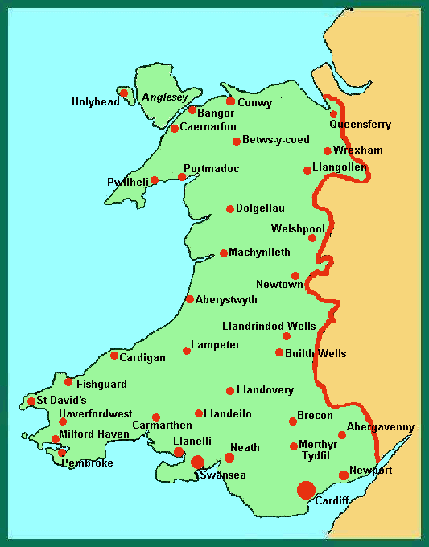
ME/CFS
Fibromyalgia
Long Covid
Wales – Support Groups
Support Group / Organisation | Conditions Supported | E‑mail | City / Region
WAMES (Welsh Association of ME & CFS Support) | ME / CFS (including fibromyalgia overlap) | helpline@wames.org.uk | Cardiff / national Wales
FibroSupport – Wales | Fibromyalgia | admin@fswales.org | Bargoed, Caerphilly (CF81)
Cymru Versus Arthritis – local groups (e.g. Brecon, Swansea, Colwyn Bay, Buckley etc.) | Arthritis, MSK, fibromyalgia, lupus, gout | walessupport@versusarthritis.org | Various towns across Wales (e.g. Swansea, Powys, Flintshire, Gwynedd)
Crohn’s & Colitis UK – Wales helpline | Crohn’s disease & ulcerative colitis | via website helpline email | Wales‑wide (HQ covers England & Wales)
Kidney Care UK – Support Line | Kidney disease / chronic kidney illness | support@kidneycareuk.org | UK‑wide including Wales (HQ in Wales)
Cwm Taf Morgannwg WISE CTM service | Chronic conditions, pain management, self‑management | CTM.WISE@wales.nhs.uk | Bridgend / Merthyr / Rhondda Taff
Aneurin Bevan UHB – Post‑Covid Recovery Service | Post‑COVID / Long Covid support (adults) | abb.symptommanagementservice@wales.nhs.uk | Gwent region (e.g. Newport, Blaenau Gwent)

Slide 4
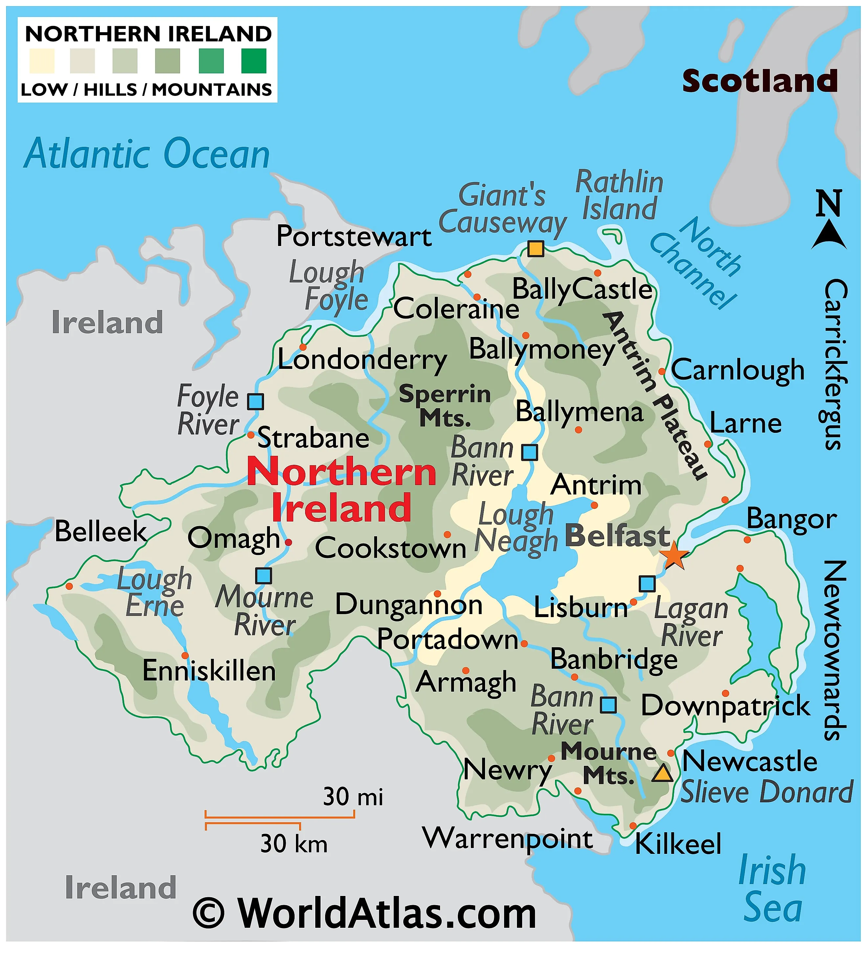
ME/CFS
Fibromyalgia
Long Covid
Northern Ireland – Support Groups
Support Group Name | What They Support | City / Region | Email
Fibromyalgia Awareness NI (FM.A.NI) | Fibromyalgia | Coleraine + NI-wide | info@fmani.uk; debs_47@hotmail.co.uk
Chronic Pain Survivors NI | Chronic pain conditions | Northern Ireland | chronicpainsurvivors@yahoo.co.uk
Hope 4 ME & Fibro NI | ME / Fibromyalgia | Northern Ireland | hope4mefibro@outlook.com
Ballymena Fibromyalgia Support Group | Fibromyalgia | Ballymena | (via contact: Caroline Campbell)
East Belfast Fibromyalgia Support Group | Fibromyalgia | East Belfast | (via Joan)
FSNDA | Fibromyalgia / chronic fatigue etc. | NI (Antrim area) | fsnda@hotmail.co.uk
Disability Owl Shed Support Team | Fibromyalgia, PTSD, bipolar, chronic issues | Newtownabbey, Co Antrim | disabilityowlshed16@gmail.com

Slide 5
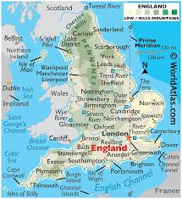
ME/CFS
Fibromyalgia
Long Covid
England– Support Groups
Support Group Name | What They Support | City / Region | Email
Sheffield ME & Fibromyalgia Group | ME/CFS & Fibromyalgia | Sheffield | info@sheffieldmegroup.co.uk
Bristol ME Support Group | ME / ME‑CFS | Bristol | (via website – not publicly listed)
Positive Support Group (Notts) | ME/CFS, Fibromyalgia, Long Covid | Nottinghamshire | sophy.wynne@hotmail.co.uk
Fibromyalgia Action UK (national helpline) | Fibromyalgia | Wolverhampton / UK-wide | charity@fmauk.org
Action for ME | ME / ME‑CFS | Keynsham (HQ) | infosupport@actionforme.org.uk
ME Association (nationwide) | ME / ME‑CFS | Gawcott (Buckinghamshire) | via website / local group listing
Long Covid Support (charity HQ) | Long Covid | London | info@longcovid.org
Peer Partnership Long Covid Peer Support | Long Covid | England-wide | info@peerpartnership.org
Darnall Well Being (Sheffield) | Long Covid support | Sheffield | dwb.enquiries@darnallwellbeing.org.uk
Keeping Well NWL – Mindfulness group | Long Covid (NW London) | London / NW London | keepingwell.nwl@nhs.net

